Slide 1


FPT SOFTWARE
Machine Learning Fundamentals
10/02/18

Slide 2
Supervised Learning
Lecture 2: Supervised Learning
Outline:
Regression and Classification
Inductive Learning
Decision Trees
Bayesian Learning
Neural Networks
Model Ensembles
Learning Theory
Support Vector Machine
Exercise

Slide 3
Supervised Learning
Lecture 2: Supervised Learning
Outline:
Regression and Classification
Inductive Learning
Decision Trees
Bayesian Learning
Neural Networks
Model Ensembles
Learning Theory
Support Vector Machine
Exercise

Slide 4
Supervised Learning
What is Supervised Learning?
In supervised learning, we are given a data set and already know what our correct output should look like, having the idea that there is a relationship between the input and the output.
Supervised learning problems are categorized into "regression" and "classification" problems. In a regression problem, we are trying to predict results within a continuous output, meaning that we are trying to map input variables to some continuous function. In a classification problem, we are instead trying to predict results in a discrete output. In other words, we are trying to map input variables into discrete categories.
Example:
Predictive Pricing Models
Objects Recognition Models
…

Slide 5
Supervised Learning
What is Supervised Learning?
In supervised learning, we are given a data set and already know what our correct output should look like, having the idea that there is a relationship between the input and the output.
Supervised learning problems are categorized into "regression" and "classification" problems. In a regression problem, we are trying to predict results within a continuous output, meaning that we are trying to map input variables to some continuous function. In a classification problem, we are instead trying to predict results in a discrete output. In other words, we are trying to map input variables into discrete categories.
Example:
Predictive Pricing Models
Objects Recognition Models
…

Slide 6
Linear Regression

Slide 7
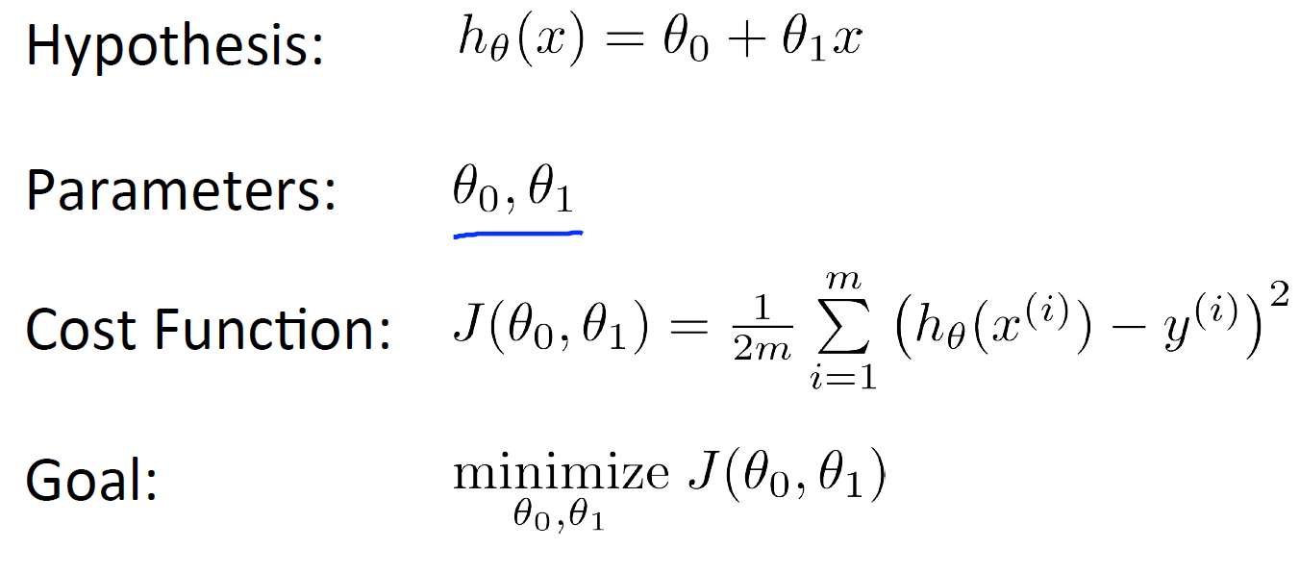
Linear Regression
Linear Regression with One Variable
Cost Function

Slide 8
Linear Regression
Linear Regression with One Variable
Cost Function

Slide 9
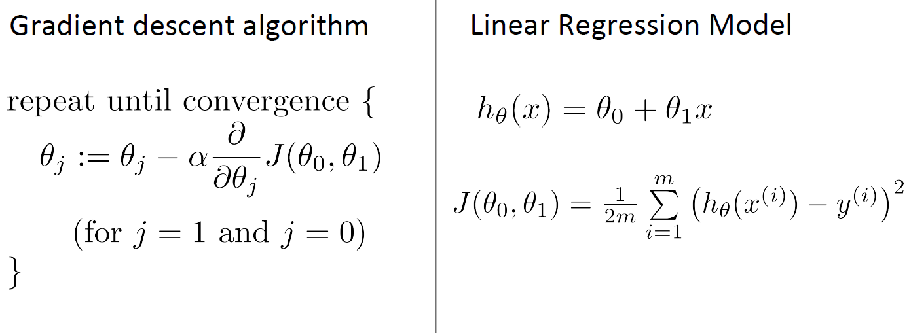
Linear Regression
Linear Regression with One Variable
Gradient Descent

Slide 10
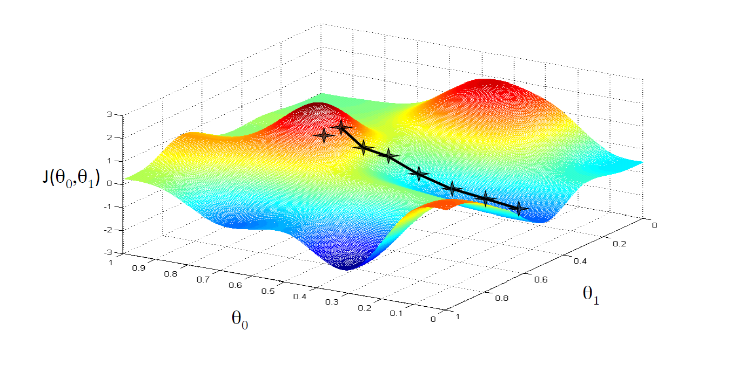
Linear Regression
Linear Regression with One Variable
Gradient Descent

Slide 11
Linear Regression
Linear Regression with One Variable
Gradient Descent
What is the problem?
Convex vs. Non-convex function
Gradient Descent for Linear Regression
Batch Gradient Descent
Mini-batch Gradient Descent
Stochastic Gradient Descent

Slide 12
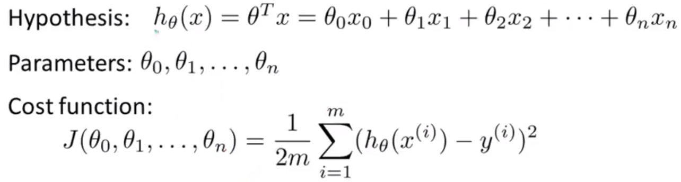
Linear Regression
Linear Regression with Multiple Variables |
Multivariate Linear Regression
Multiple Features

Slide 13
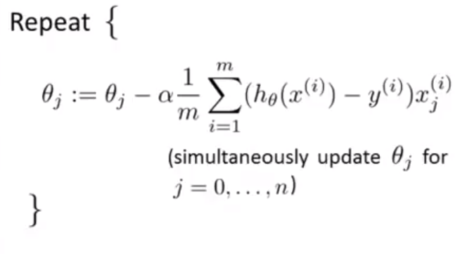
Linear Regression
Linear Regression with Multiple Variables |
Multivariate Linear Regression
Multiple Features
Gradient Descent for multiple variables

Slide 14
Linear Regression
Linear Regression with Multiple Variables |
Multivariate Linear Regression
Multiple Features
Gradient Descent for multiple variables
Feature Scaling
Learning Rate
Features and Polynomial Regression

Slide 15


Linear Regression
Linear Regression with Multiple Variables |
Multivariate Linear Regression
Normal Equation
Method to solve for theta analytically.
Problem:
What if is non-invertible? (singular/degenerate)
Redundant features (linearly dependent)
Too many features
Delete some features, or use regularization

Slide 16

Linear Regression
Gradient Descent vs. Normal Equation
m training examples, n features
Gradient Descent | Normal Equation
Need to choose α | No need to choose α
Needs many iterations | Don’t need to iterate
Work well even when n is large | Need to compute
 | Slow if n is very large

Slide 17
Logistic Regression

Slide 18
Logistic Regression
Classification Problems
Why not Linear Regression for Classification Problems?
Logistic Regression is algorithm for Classification problems
Multiclass Classification
The problem of Overfitting

Slide 19
Logistic Regression
Classification Problems
Email: Spam/Not Spam
Online Transactions: Fraudulent (yes/no)
Why not Linear Regression for Classification Problems?
Logistic Regression is algorithm for Classification problems
Hypothesis Representation
Decision Boundary
Logistic Regression Model
Multiclass Classification
The problem of Overfitting

Slide 20
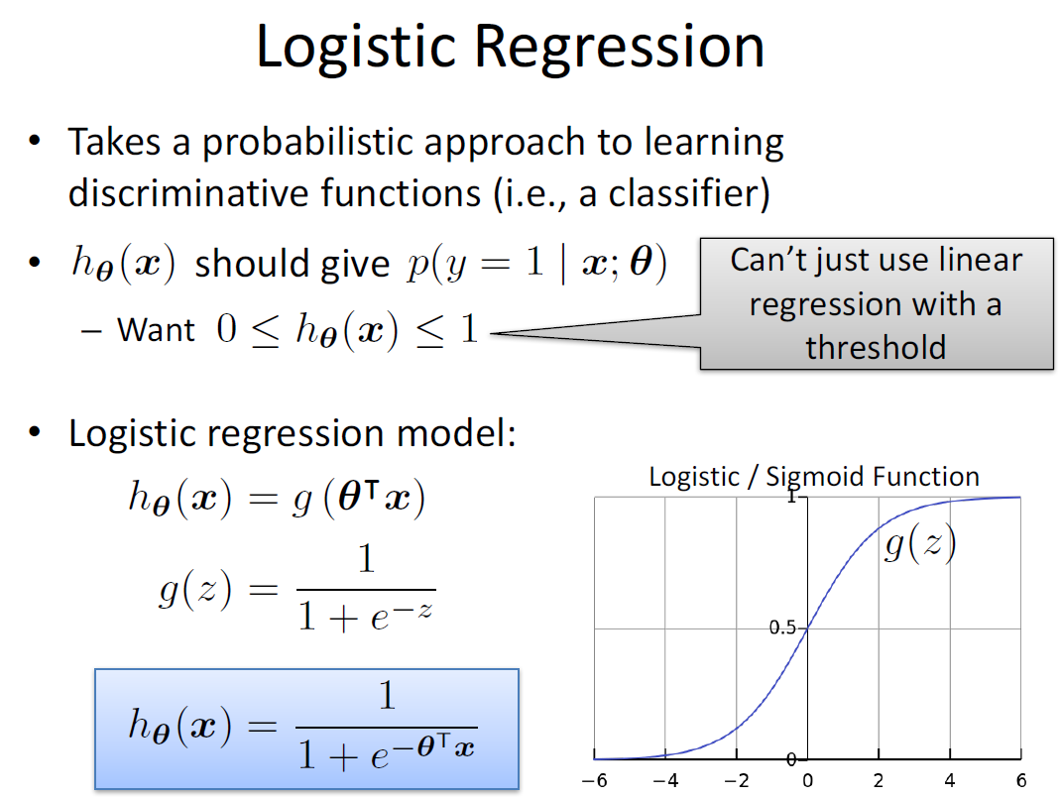
Logistic Regression

Slide 21

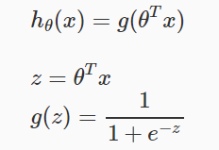
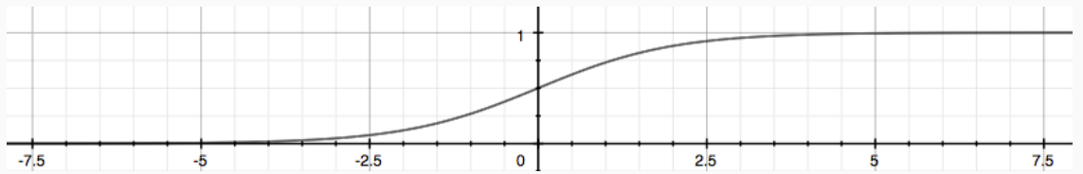
Logistic Regression
Hypothesis Representation
We could approach the classification problem ignoring the fact that y is discrete-valued, and use our old linear regression algorithm to try to predict y given x.
However, it is easy to construct examples where this method performs very poorly. Intuitively, it also doesn’t make sense for hθ(x) to take values larger than 1 or smaller than 0 when we know that y ∈ {0, 1}.
To fix this, let’s change the form for our hypotheses hθ(x) to satisfy 0≤hθ(x)≤1. This is accomplished by plugging into the Logistic Function.
Our new form uses the "Sigmoid Function," also called the "Logistic Function":

Slide 22
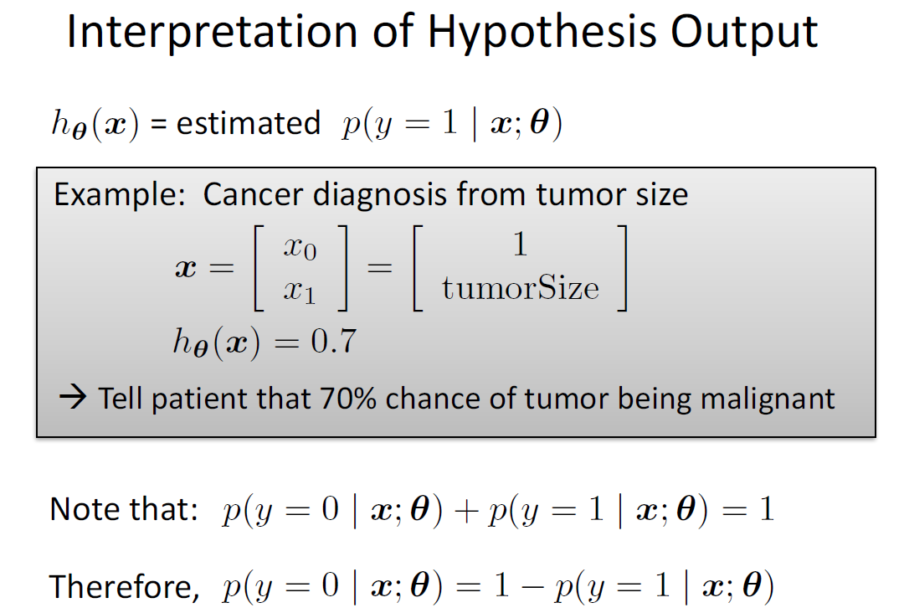
Logistic Regression

Slide 23
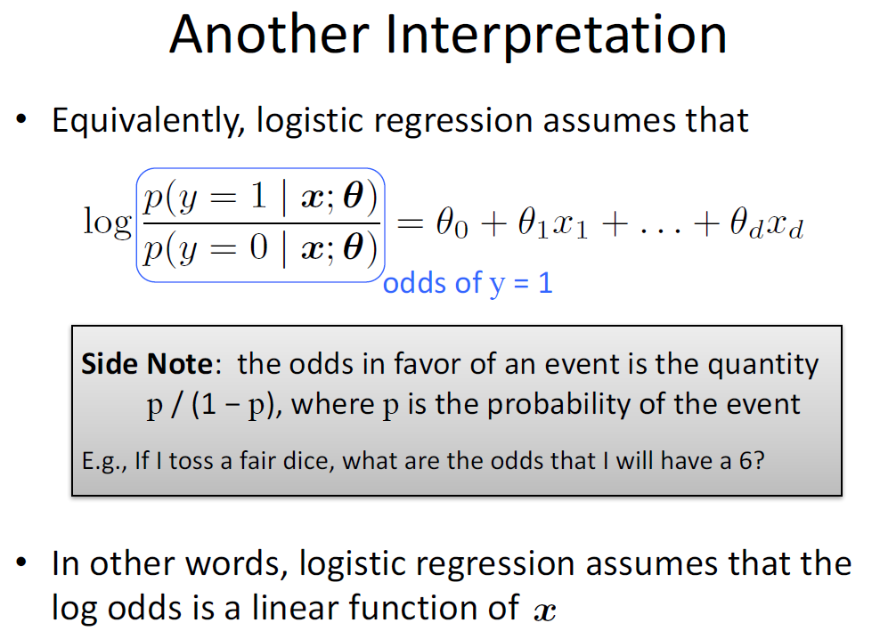
Logistic Regression

Slide 24
Logistic Regression

Slide 25
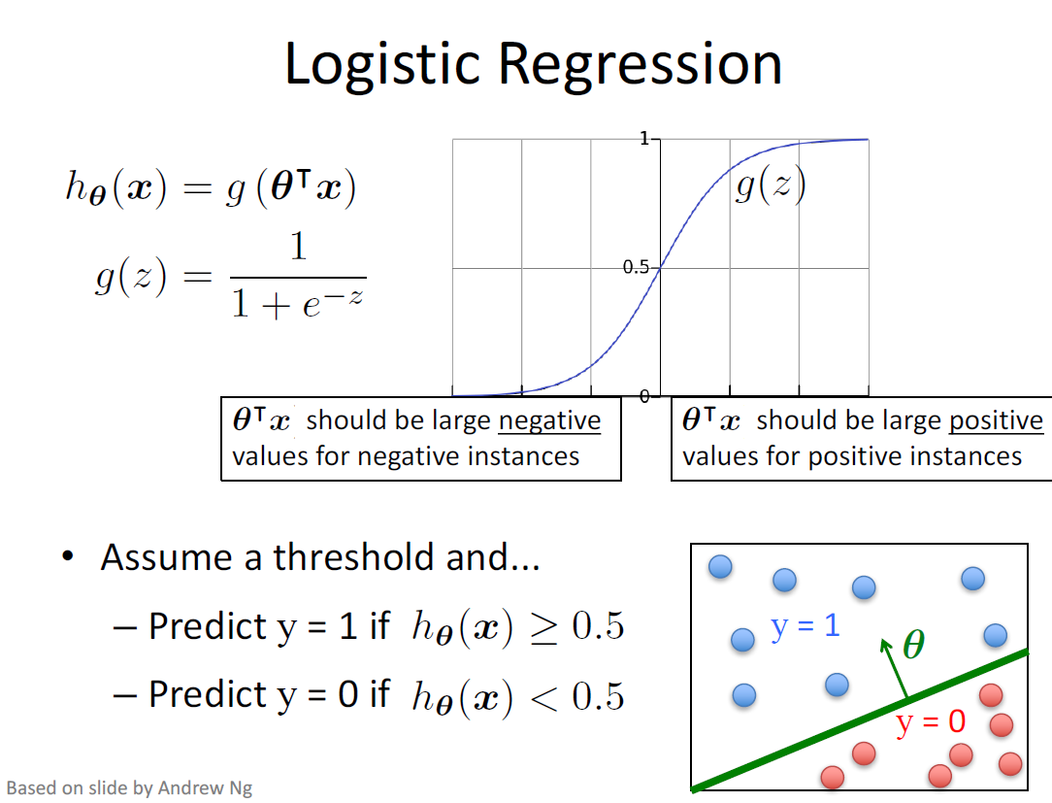
Logistic Regression

Slide 26
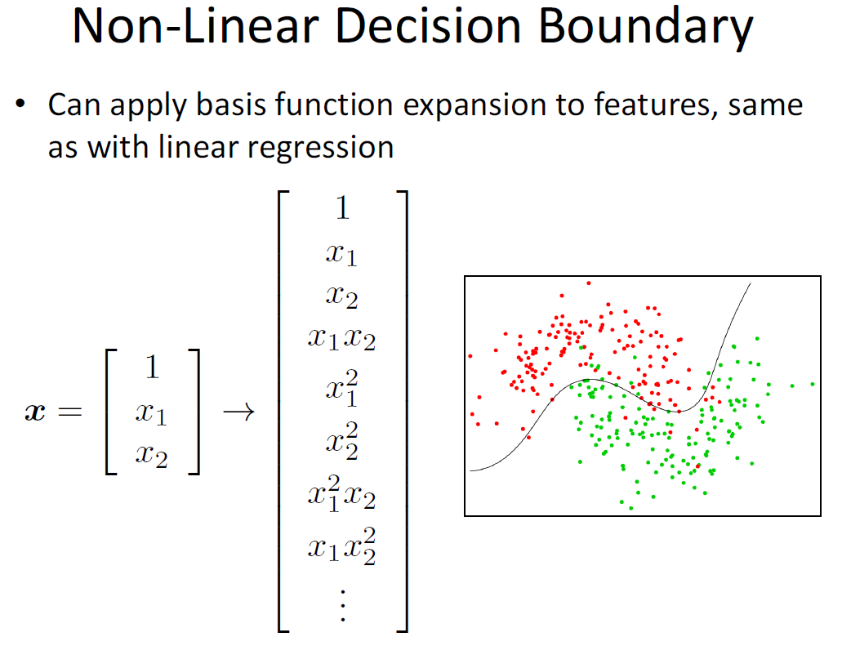
Logistic Regression

Slide 27
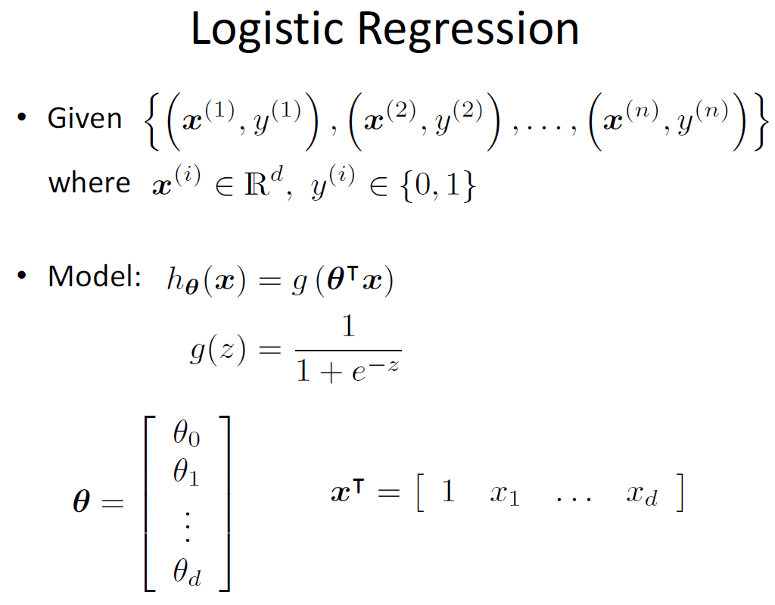
Logistic Regression

Slide 28
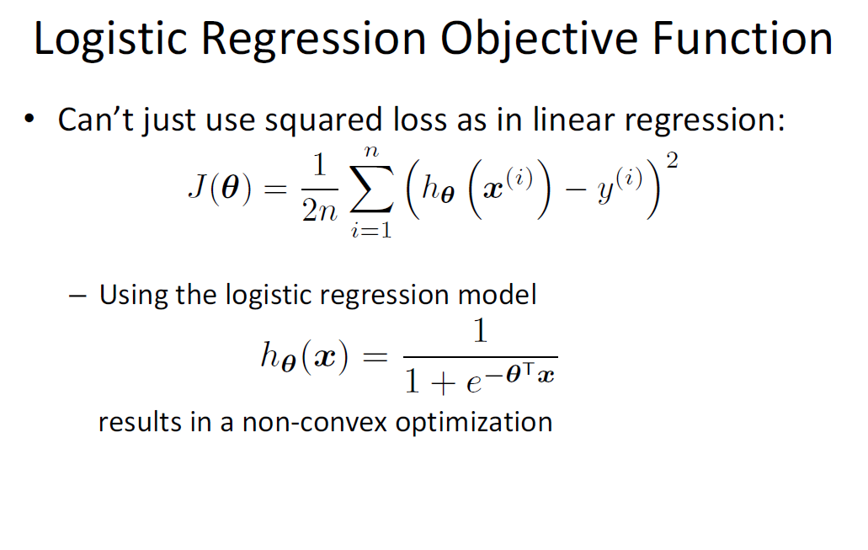
Logistic Regression

Slide 29
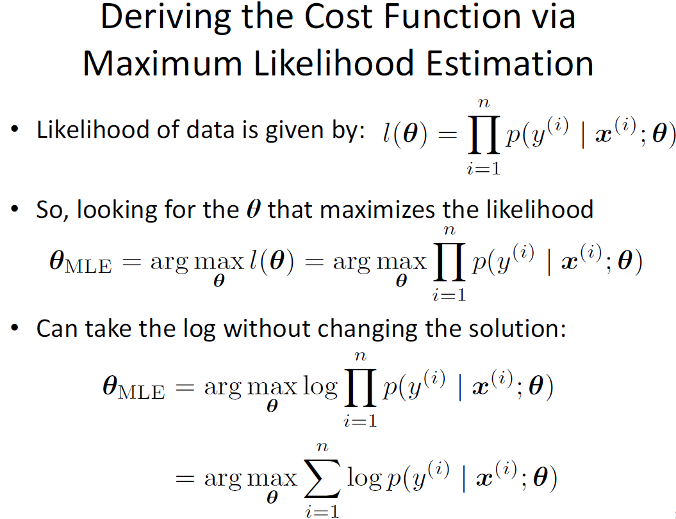
Logistic Regression

Slide 30
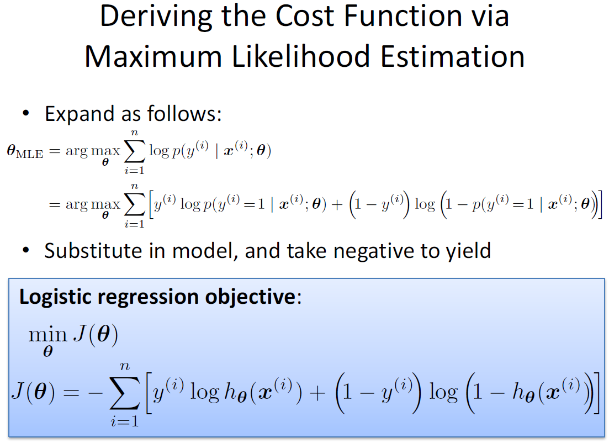
Logistic Regression

Slide 31
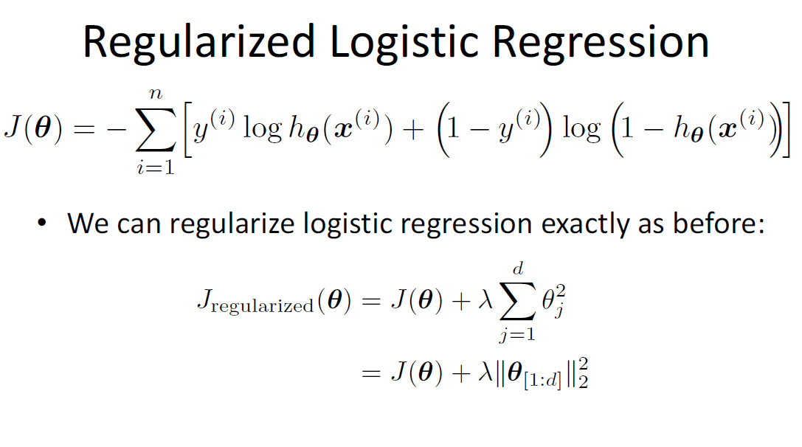
Logistic Regression

Slide 32
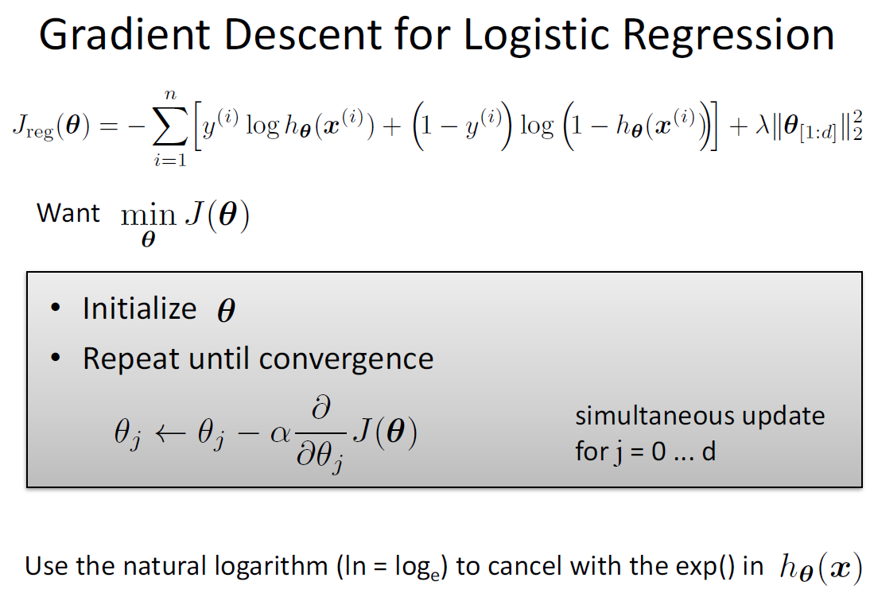
Logistic Regression

Slide 33
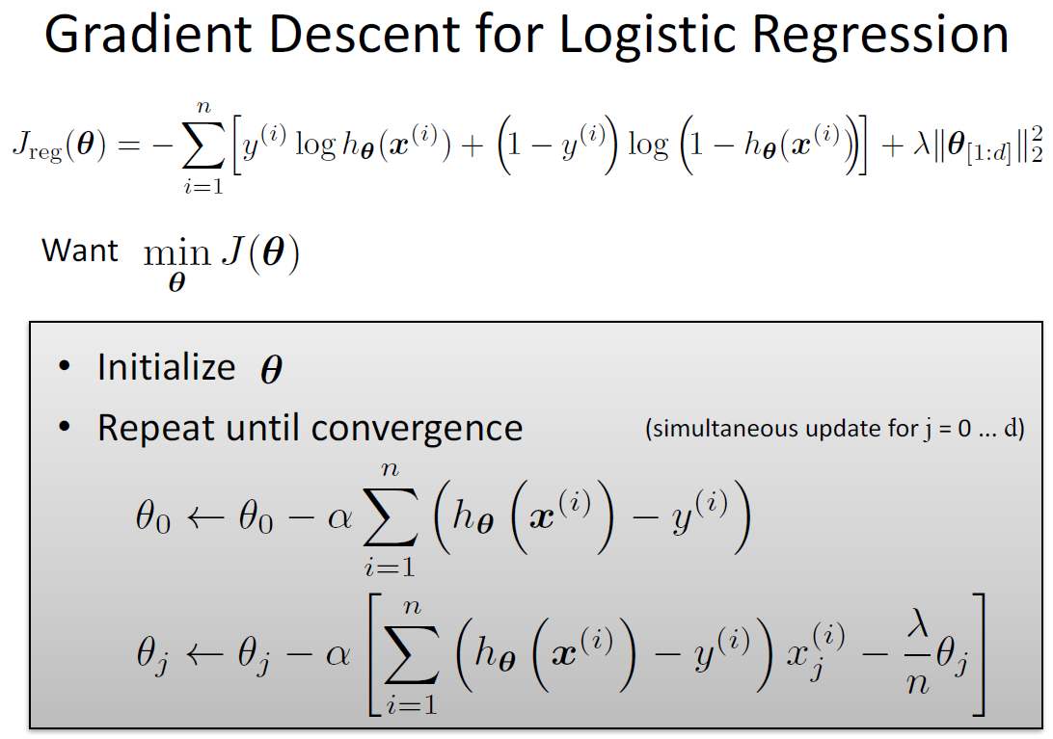
Logistic Regression

Slide 34
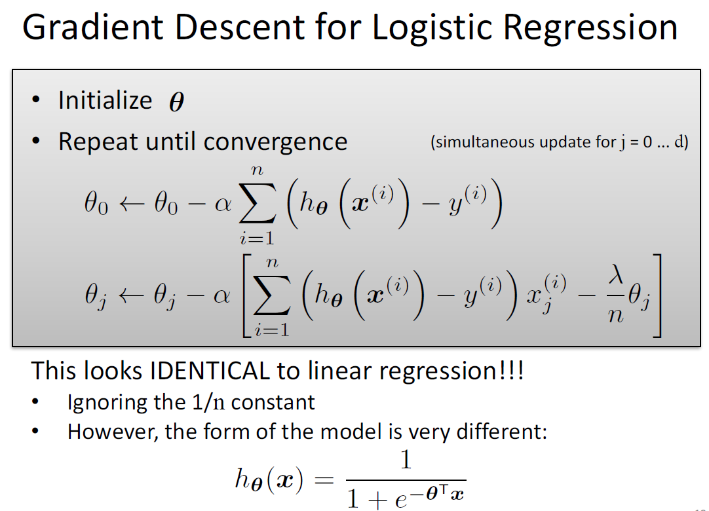
Logistic Regression

Slide 35
Logistic Regression
Classification Problems
Why not Linear Regression for Classification Problems?
Logistic Regression is algorithm for Classification problems
Multiclass Classification
The problem of Overfitting

Slide 36
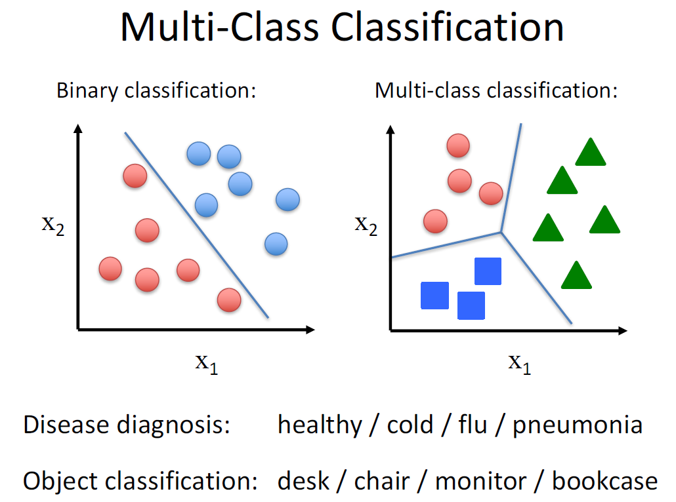
Logistic Regression

Slide 37
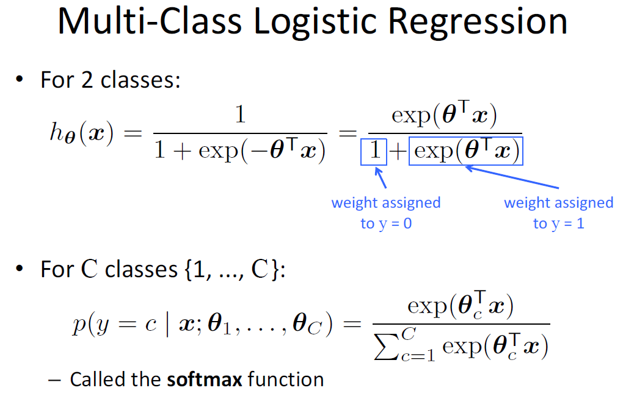
Logistic Regression

Slide 38
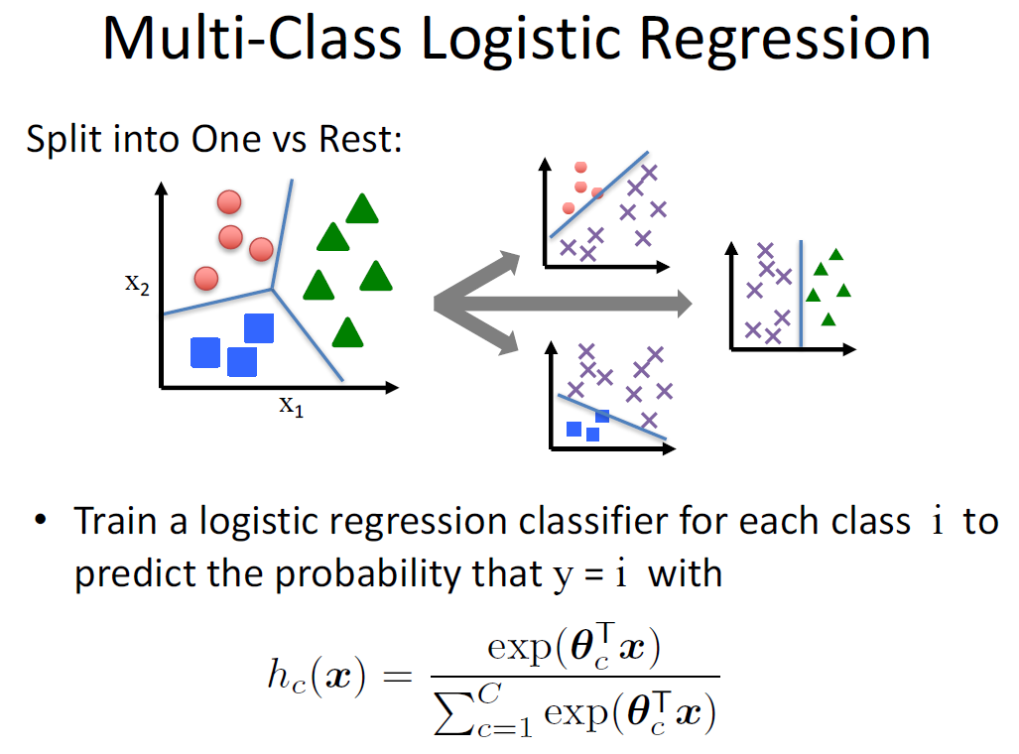
Logistic Regression

Slide 39
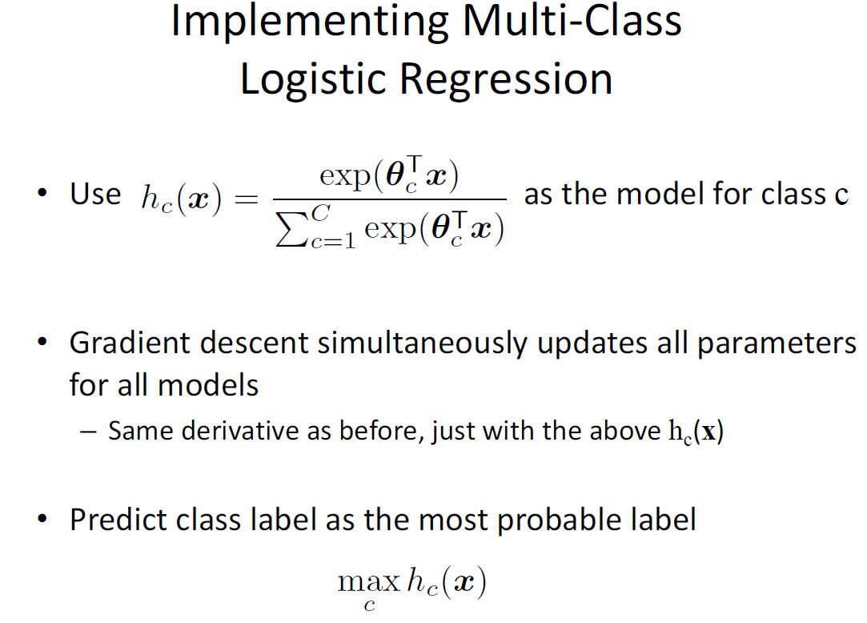
Logistic Regression

Slide 40
Logistic Regression
Classification Problems
Why not Linear Regression for Classification Problems?
Logistic Regression is algorithm for Classification problems
Multiclass Classification
The problem of Overfitting

Slide 41
Regression
Exercise

